Slide 1

AE 482
Farm Machine Design
Unit 1: Engineering Materials
Mr. Joseph AVEYIRE
aveyire@yahoo.com // 024 4652593

Slide 2
UNIT 1: Introduction
This unit describes engineering materials and determines factors that affect the choice of engineering materials:
Section 1-2 handles engineering materials
Section 2-2 tackles factors considered in choosing engineering materials

Slide 3
UNIT 1: Learning Objectives
Classify engineering materials
Identify properties of engineering materials
Determine engineering requirements of materials
Explain the effect of strength of materials
Explain the effect of material cost
Explain the effect of engineering manufacturing processes
Effect of life span and light weight of component

Slide 4
UNIT 1: Engineering Materials
Definition: A material is that out of which anything is or may be made of. A material relates itself to matter.
Based on chemical make-up and atomic structure, solid materials are grouped into:
Metals
Ceramics, and
Organic materials

Slide 5
UNIT 1: Engineering Materials
some materials fall between certain categories and
some have been engineered
Examples are:
Composites, semiconductors and biomaterials
Smart (or intelligent) materials: utilized in high-technology (or high-tech)
Nano-engineering materials (very recently developed)

Slide 6
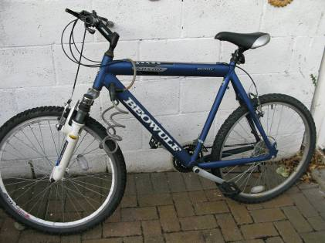
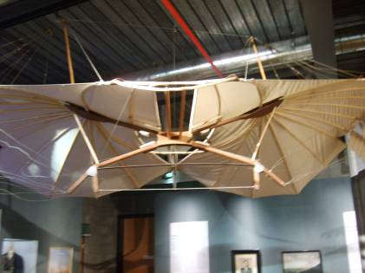
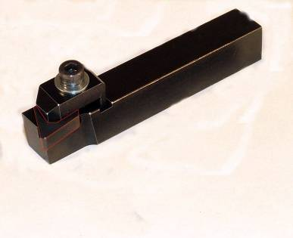
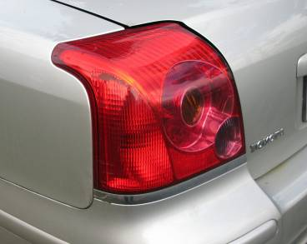
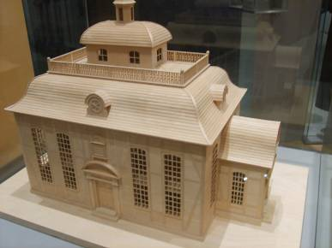

UNIT 1: Engineering Materials
Materials used in the design and manufacture of products include:
Plastics
Wood
Composites
Ceramics
Metals
Fabrics
Linen, cotton, nylon, Kevlar
Tungsten carbide tool bit
Steel, aluminium
Layers of polycarbonate, aluminium & acrylic
Balsa wood model
Acrylic lens

Slide 7
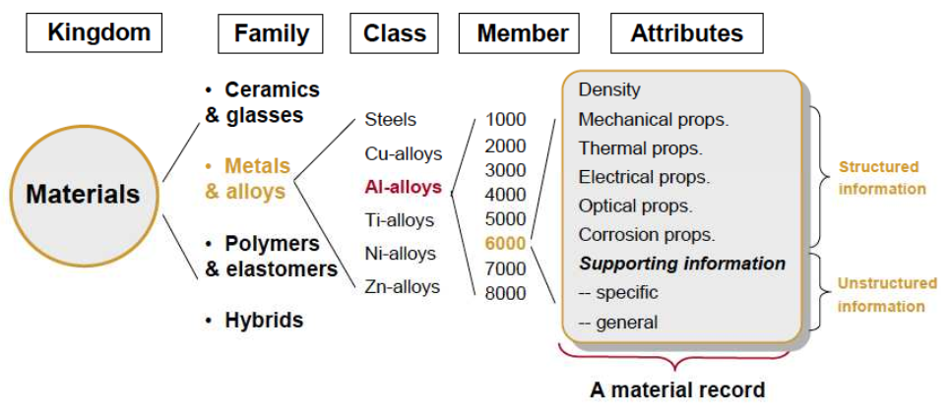
UNIT 1: Engineering Materials
Engineering materials can be broken down based on specific criteria as shown in Figure 1.1:
Figure 1.1: Designation of engineering materials

Slide 8
UNIT 1: Metals
Metals easily provide an electron during bonding and electrical conductivity.
Metals are crystalline in nature
There are two groups of metals:
Ferrous : Cast iron, Steel etc.,
Non-ferrous: Cu, Al, Zn, Sn etc.
Desired properties of metals are often found in alloys

Slide 9
UNIT 1: Metals
Metals generally possess certain characteristics :
Good thermal and electrical conductivity,
Lustre, Malleable
High strength and Formable
Metals can be:
Crystalline
Amorphous
Quasi-crystalline

Slide 10
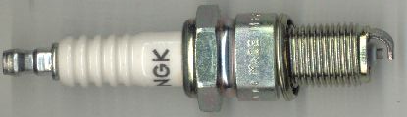
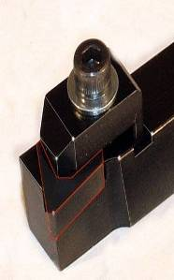
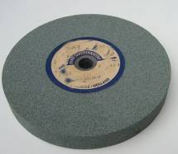
UNIT 1: Ceramic Materials
Ceramics are crystalline compounds of metallic and non-metallic elements, examples include:
Oxides (alumina – insulation and abrasives, zirconia – dies for metal extrusion and abrasives)
Carbides (tungsten-carbide tools)
Nitrides (cubic boron nitride, 2nd in hardness to diamond)

Slide 11
UNIT 1: Ceramic Materials
Graphite is also categorized in ceramics
Characteristics of ceramics:
Brittle,
Hardness,
Abrasiveness
High temperature strength
Examples: Sand, Concrete, Glass, Boron nitrate etc.

Slide 12
UNIT 1: Organic Materials
They are polymeric materials composed of long molecular chains of carbon compounds. Polymers are solids
Characteristics of organic materials:
Light weight,
Ductile,
Combustible
Examples: Rubber, Plastics, Wood, Lubricants, Textiles etc.

Slide 13
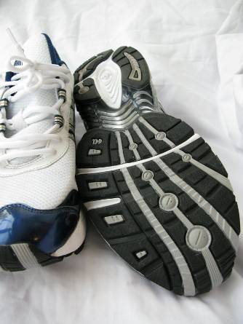
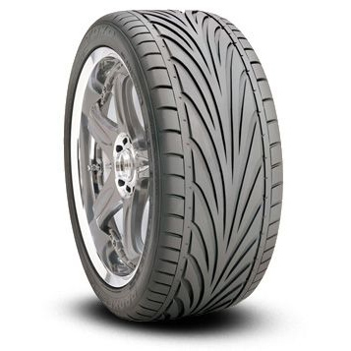
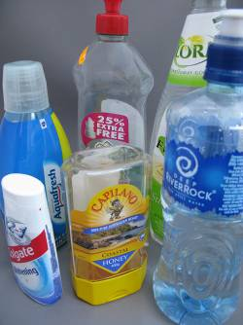
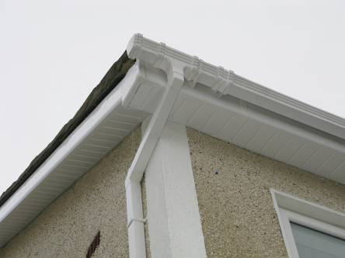
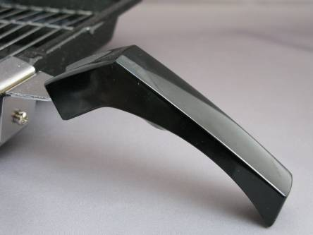

UNIT 1: Organic Materials (Polymers)
Polymers can be classified as:
Thermoplastic
Thermoset
Elastomers
Thermoplastics | Thermosets | Elastomers
Acrylics | Epoxy resins | Rubbers
Nylons | Phenolic | Silicones
PVC | Polyesters | Polyurethanes
Polyethylene
Phenol formaldehyde
Urea formaldehyde
PVC gutters
Polyethylene
Rubber
Rubber

Slide 14
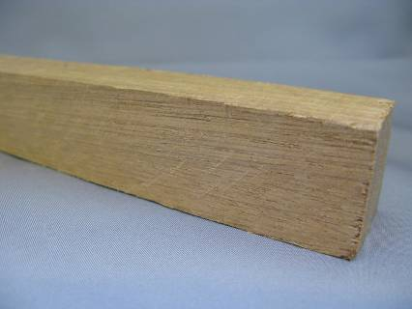
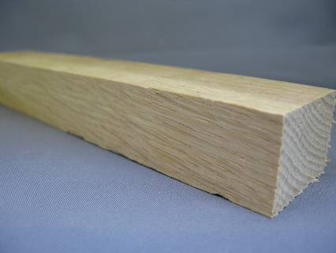
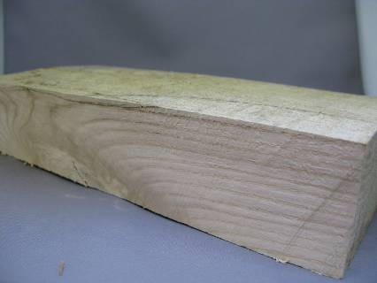
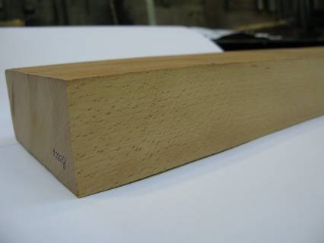
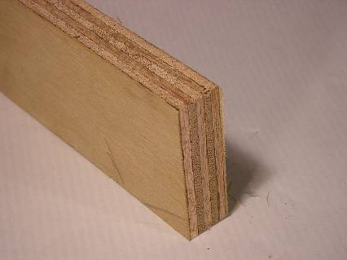
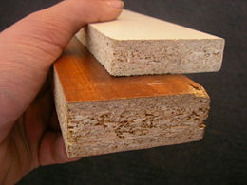
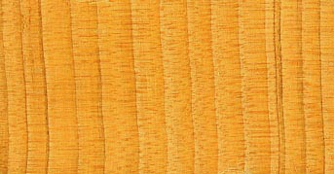
UNIT 1: Organic Materials
Wood can be further categorised as:
Hardwood
Softwood
Manufactured board
Mahogany
Oak
Ash
Beech
Chipboard with Veneer
Plywood
Cedar
Hardwood | Softwood | Manufactured Board
Oak | Pine | Plywood
Ash | Cedar | Blockboard
Beech | Fir | MDF
Sycamore | Spruce | Melamine board

Slide 15
UNIT 1: Properties of Materials
It is a factor that influences the qualitative or quantitative response of a given material to imposed stimuli and constraints such as forces, temperatures, etc.
It is independent of the dimension or shape.
In principle, they have a statistical behavior,
Categories of properties include:
Mechanical
Thermal
Electrical, etc.

Slide 16
UNIT 1: Mechanical Properties
They are characteristics of a material that describe its behaviour under the action of external forces.
Knowledge of mechanical properties of materials is essential in construction of mechanically sound structure.
Examples:
Strength: to sustain loads (tension, shear, bend),
Stiffness: to resist elastic deflection (E)
Ductility: ability to undergo tensile deformation,
Hardness: resist plastic deformation-indentation.

Slide 17
UNIT 1: Chemical Properties
They characteristics the response of a material to chemicals
Examples:
Corrosion resistance
Chemical composition,
Acidity or alkalinity
Solubility, etc.

Slide 18
UNIT 1: Physical Properties
They are employed to describe a material under conditions in which external forces are not concerned.
Examples:
  Dimensions (i.e., size and shape) of the material.
  Density
  Porosity
Structure, etc

Slide 19
UNIT 1: Engineering Requirements of Materials
Fabrication requirement is the ease to shape the material (machinability, ductility, castability, Weldability, heat-treatability).
Service requirement is the ability of the material to stand up to service condition of strength, wear, corrosion etc.
Economic requirement demand that the engineering part should be made with minimum overall cost

Slide 20
UNIT 1: Factors that Affect Choice of Materials
Strength of material,
Cost of material,
Type of manufacturing process,
Form or profile of part,
Life span and light-weight

Slide 21
UNIT 1: Strength of Engineering Materials
A material is expected to guarantee against strength failure:
Type of stress (tensile, bending, torsion etc.)
State of stress (static, dynamic, complex)
Environment (corrosion, erosion, cavitation)

Slide 22
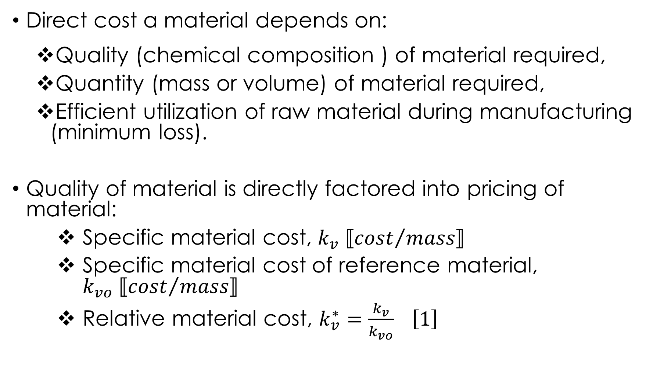
UNIT 1: Cost of Materials
Direct cost a material depends on:
Quality (chemical composition ) of material required,
Quantity (mass or volume) of material required,
Efficient utilization of raw material during manufacturing (minimum loss).
Quality of material is directly factored into pricing of material:
Specific material cost, $k_{v} ⟦{cost}/{mass}⟧$
Specific material cost of reference material, $k_{vo} ⟦{cost}/{mass}⟧$
Relative material cost, $k_{v}^{∗}=\frac{k_{v}}{k_{vo}} \left[1\right]$

Slide 23
UNIT 1: Strength and Cost
Example: For the cold rolled round steels, St37-2 and St50-2, deduce an expression which shows the cost-bending strength relationship. Which of the two materials will be suitable?
 | k*_{v} | R_{p0,2} (N/mm²) | σ_{b}[N/mm²]
St 32- 2 | 1.0 | 240 | 340
St 50-2 | 1.1 | 300 | 420

Slide 24
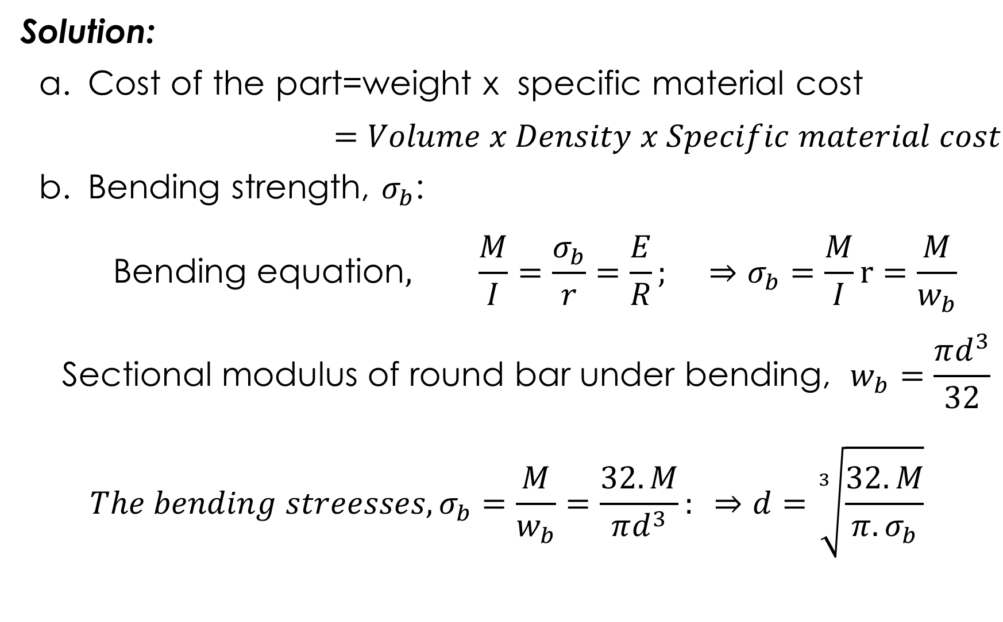
UNIT 1: Strength and Cost
Solution:
Cost of the part=weight x specific material cost
$$=Volume x Density x Specific material cost$$
Bending strength, $σ_{b}$:
$$\text{Bending} \text{equation}, \frac{M}{I}=\frac{σ_{b}}{r}=\frac{E}{R}; ⇒σ_{b}=\frac{M}{I}r=\frac{M}{w_{b}}$$
$${\text{Sectional} \text{modulus} \text{of} \text{round} \text{bar} \text{under} \text{bending}\text{,} w}_{b}=\frac{πd^{3}}{32}$$
$$The bending streesses, σ_{b}=\frac{M}{w_{b}}=\frac{32.M}{πd^{3}}: ⇒d=\sqrt[3]{\frac{32.M}{π{.σ}_{b}}}$$

Slide 25
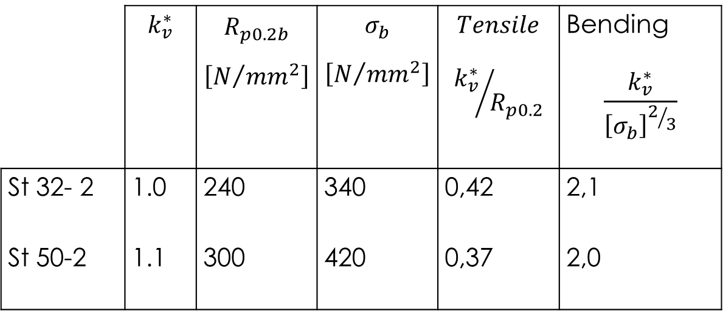
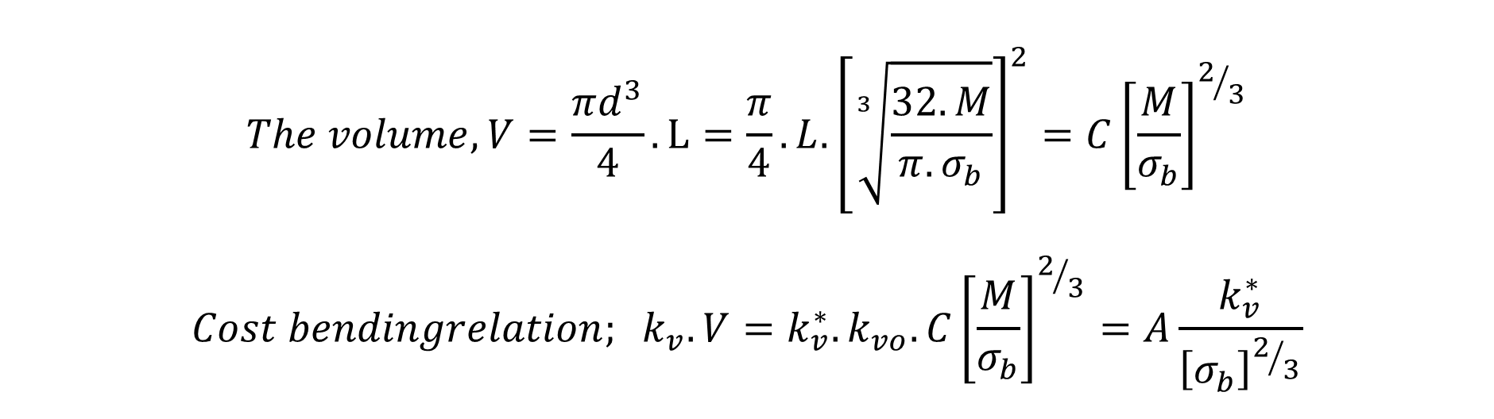
UNIT 1: Strength and Cost
$$The volume, V=\frac{πd^{3}}{4}.L=\frac{π}{4}.L.{\left[\sqrt[3]{\frac{32.M}{π{.σ}_{b}}}\right]}^{2}=C{\left[\frac{M}{σ_{b}}\right]}^{2/3}$$
$$Cost bendingrelation; k_{v}.V=k_{v}^{∗}.k_{vo}.C{\left[\frac{M}{σ_{b}}\right]}^{2/3}=A\frac{k_{v}^{∗}}{{\left[σ_{b}\right]}^{2/3}}$$
 | $$k_{v}^{∗}$$ | $$R_{p0.2b}$$ $$\left[N/{{mm}^{2}}\right]$$ | $$σ_{b}$$ $$\left[N/{{mm}^{2}}\right]$$ | $$Tensile$$ $${k_{v}^{∗}}/{R_{p0.2}}$$ | Bending $$\frac{k_{v}^{∗}}{{\left[σ_{b}\right]}^{2/3}}$$
St 32- 2 | 1.0 | 240 | 340 | 0,42 | 2,1
St 50-2 | 1.1 | 300 | 420 | 0,37 | 2,0
St50-2 is suitable

Slide 26
UNIT 1: Engineering Manufacturing Processes
.
.
.
Technological properties of a material must correspond to the manufacturing process selected.
Example, weldability requires a carbon content less than or equal to 0.22% .
Table 1-2: Manufacturing requirements of manufacturing processes
Process | Property | Required of the material
Casting | Castability | low liquefying & solidifying temp. good form filling ability (form thin fluid layer, less shrinkage and less surface tension of the melted fluid). less tendency towards blowhole and gas bubble formation (less gas dissolving ability and less shrinkage of the liquid). less internal tension due to shrinkage when solidifying.
Rolling Forging Pressing | Malleable | good form yielding capacity (lower cold or warm yielding strength). good sliding ability of the grain structure (cubic face centred or body-centred cubic metallic lattice)

Slide 27
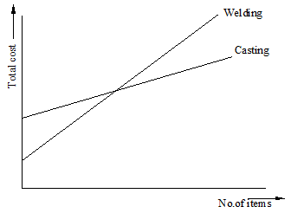
UNIT 1: Engineering Manufacturing Processes
Number of elements to be produced also determines the indirect manufacturing process due to cost reason (Fig 1-4).
Figure 1-4: Cost of manufacturing processes and number items produced

Slide 28
UNIT 1: Form (Profile / Section) of a Part
Factors that determine the form of a part:
Function of the element,
Stress distribution and
Strength of material (Favourable and unfavourable stress capability)
Optimal form of a part utilizes the favourable stress ability of the material to compensate the unfavourable stress distribution.

Slide 29
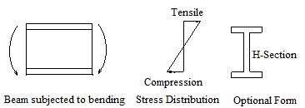
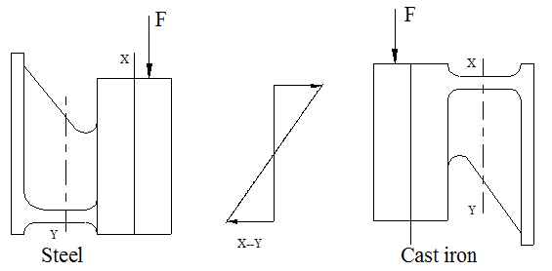
UNIT 1: Form (Profile / Section) of a Part
Example:

Slide 30
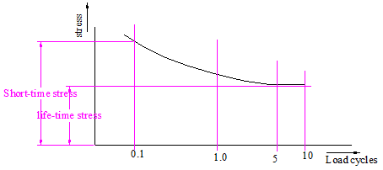
UNIT 1: Life Span and Light-Weight Design
Machine parts are generally subjected to dynamic loading and therefore are designed based on fatigue strength of the material
A part therefore subjected to varied stresses will experience different life cycles (Fig 1-5)

Slide 31
UNIT 1: Life Span and Light-Weight Design
Household implements, military automobiles, weapons, computers, mobile phones etc. are designed based on short-time strength of the material due to fast technological development
Some measures against material losses:
Rust resistant material against aggressive medium.
Provision of outer coating against bad weather.
Running-in bearings against frictional wear.
Prevent pitting on gears.

Slide 32
UNIT 1: Life Span and Light-Weight Design
For the same functional ability, light-weighted parts are preferred for the following reasons:
High driving power by automobiles {P = f(n) i.e. high speed}
Low power requirements by machines with low reduced initial masses.
Low operational cost by automobiles (minimum fuel).
Light construction can be achieved by:
Creating favourable boundary conditions
Choice of an appropriate profile and form
Choice of an appropriate material

Slide 33

Thank You
For any concerns, please contact
elearning@knust.edu.gh
elearningknust@gmail.com
0322 191132

